Slide 1
INTERNAL ASSESSMENT III • QUANTUM COMPUTING
QUANTUM KEY
RECOVERY
H
→
Uƒ
→ H
MEASURE
Toy Even–Mansour Cipher × Simon’s Algorithm
From a hidden XOR period to the secret key — proven mathematically and checked with quantum simulation.
3-BIT CIPHER
6-QUBIT ORACLE
LIVE QISKIT DEMO
23CS2037 · October 2026
Notes:
Introduce the topic and say: Our goal is not simply to print a key. We mathematically derive a hidden XOR-period problem, construct a reversible quantum oracle, measure the circuit, solve equations and validate the recovered keys. This condensed deck leads directly into a live demo.

Slide 2
QUANTUM COMPUTING / EVEN–MANSOUR × SIMON
02
THE ASSIGNMENT
What exactly is the given task?
Start from the given question and the additional simulation requirement.
“Toy Even–Mansour key recovery: Given E(x) = P(x ⊕ k₁) ⊕ k₂, the function f(x) = E(x) ⊕ P(x) is periodic with period k₁. Implement it for 2–3 bits and recover k₁ from the measured equations. Use Simon’s Algorithm.”
Report & comparison
Simulation & validation
Explain other algorithms and why Simon fits best.
Implement in a quantum simulator; compare theory with actual measurements.
SUCCESS CONDITION: measured equations recover k₁, and simulation agrees with theory.
IA III · QUANTUM COMPUTING · THEORY → SIMULATOR → KEY RECOVERY
02
Notes:
Read the original question in brief. Highlight that the teacher specifically demands theory versus simulated output, not just source code. Explain that comparing algorithms and showing the mathematical steps are part of the assessment.

Slide 3
QUANTUM COMPUTING / EVEN–MANSOUR × SIMON
03
PROBLEM DECODING
What is the actual cryptography problem?
A public permutation surrounds two secret XOR masks.
x
⊕ k₁
P(·)
⊕ k₂
E(x)
Plaintext
Input secret
Public permutation
Output secret
Ciphertext
KNOWN
UNKNOWN
KEY INSIGHT
P is public; we can evaluate the encryption E.
The hidden input key k₁ and output key k₂.
Build f(x) = E(x) ⊕ P(x); find its XOR period.
ENCRYPTION → PERIODIC FUNCTION → SIMON MEASUREMENTS → SECRET KEY
IA III · QUANTUM COMPUTING · THEORY → SIMULATOR → KEY RECOVERY
03
Notes:
Explain the Even–Mansour construction from left to right. XOR is bitwise addition modulo two. We know the public permutation P, but not the keys; the target is k1. The derived function f is accessible through the encryption and public permutation oracles.

Slide 4
QUANTUM COMPUTING / EVEN–MANSOUR × SIMON
04
TOY CONSTRUCTION
Our 3-bit example: complete truth table
Eight inputs; chosen keys are k₁ = 101 and k₂ = 011.
PUBLIC P: 000, 010, 011, 101, 100, 001, 110, 111
x
P(x)
x ⊕ 101
E(x)
f(x)
OBSERVATION
000
000
101
010
010
Each output f(x) occurs exactly twice. The paired input strings always differ by XOR 101.
001
010
100
111
101
010
011
111
100
111
011
101
110
101
000
100
100
001
001
101
101
001
000
011
010
110
110
011
110
000
111
111
010
000
111
The constructed function satisfies Simon’s exact two-to-one promise.
IA III · QUANTUM COMPUTING · THEORY → SIMULATOR → KEY RECOVERY
04
Notes:
Walk through one truth-table row: for x=001, x XOR 101=100, P(100)=100, E(001)=111, f(001)=111 XOR 010 = 101. Show other rows and emphasize the four pairs have distinct f outputs. The test keys are known only to the oracle-construction part of the simulator.

Slide 5
QUANTUM COMPUTING / EVEN–MANSOUR × SIMON
05
MATHEMATICAL PROOF
Why is the hidden XOR period k₁?
The input XOR mask cancels, and the remaining XOR terms reorder.
DERIVATION
COLLIDING INPUT PAIRS
f(x) = P(x ⊕ k₁) ⊕ k₂ ⊕ P(x)
f(x ⊕ k₁) = P(x) ⊕ k₂ ⊕ P(x ⊕ k₁)
Therefore f(x ⊕ k₁) = f(x)
000 ⊕101 → 101
f = 010
001 ⊕101 → 100
f = 101
010 ⊕101 → 111
f = 111
011 ⊕101 → 110
f = 000
Why 3 bits? A 2-bit permutation makes f constant, so its period cannot be uniquely recovered.
IA III · QUANTUM COMPUTING · THEORY → SIMULATOR → KEY RECOVERY
05
Notes:
Prove f(x XOR k1)=f(x) using k1 XOR k1=0 and commutativity of XOR. Point to the four pairs. Clarify that periodicity alone is not enough for Simon’s exact promise; different pairs must also have different output values. For n=2 every permutation is affine and f is constant, which motivates n=3.

Slide 6
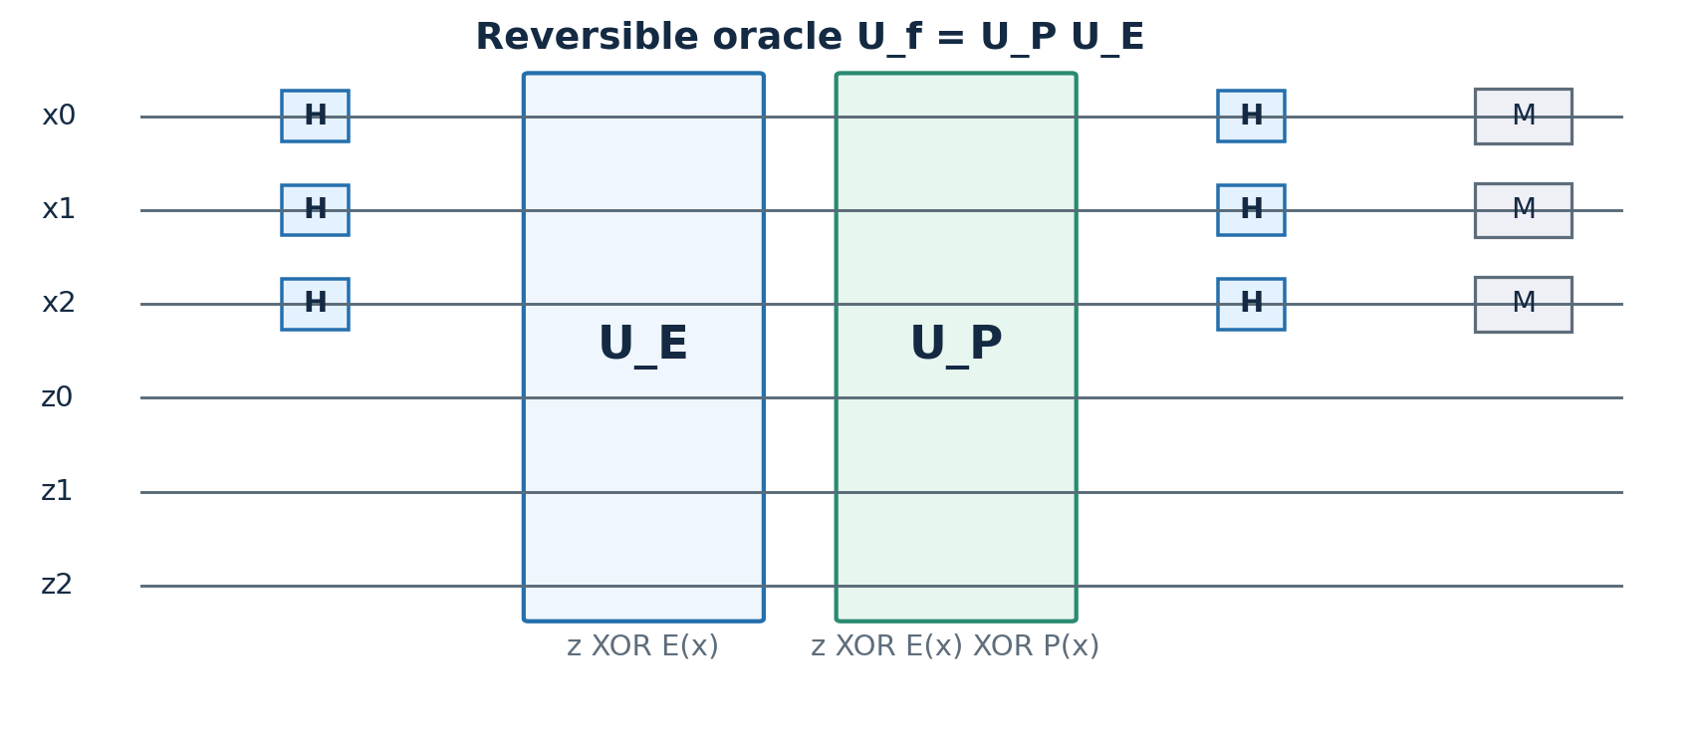
QUANTUM COMPUTING / EVEN–MANSOUR × SIMON
06
QUANTUM ALGORITHM
Simon's circuit: H → oracle → H → measure
Three input qubits + three output qubits = six qubits.
1 SUPERPOSE
2 Uƒ(x) = E(x) ⊕ P(x)
3 INTERFERE
4 MEASURE x
The oracle is reversible: Uƒ|x,z⟩ = |x,z ⊕ f(x)⟩.
IA III · QUANTUM COMPUTING · THEORY → SIMULATOR → KEY RECOVERY
06
Notes:
Discuss x register, output register z, and classical result bits. First H gives a superposition, the quantum oracle computes E(x) XOR P(x) reversibly, second H causes interference, and input measurement yields an equation orthogonal to k1. This is a conceptual circuit diagram from our validated report; generated Qiskit circuit image can be opened live.

Slide 7
QUANTUM COMPUTING / EVEN–MANSOUR × SIMON
07
WORKED SOLUTION
Recover k₁ from quantum measurement equations
Each measurement y satisfies y · k₁ = 0 (mod 2).
ONLY FOUR VALID OUTCOMES
MEASURED EQUATIONS
y = 010 ⇒ k₁,middle = 0
y = 101 ⇒ k₁,left ⊕ k₁,right = 0
Possible periods: 000 or 101
Nonzero Simon period: k₁ = 101
000
25%
010
25%
101
25%
111
25%
Then recover k₂ = E(000) ⊕ P(101) = 010 ⊕ 001 = 011.
IA III · QUANTUM COMPUTING · THEORY → SIMULATOR → KEY RECOVERY
07
Notes:
Point to the four legal measurements, each theoretically 25%. Two independent nonzero equations suffice for a 3-bit period. Define k1 components as left, middle, right, to avoid confusing the key name k1 with bit index. One equation fixes the middle bit to zero, another requires outer bits equal; nonzero promise selects 101. Compute k2 using a known input.

Slide 8
QUANTUM COMPUTING / EVEN–MANSOUR × SIMON
08
ALGORITHM CHOICE
What else could we use — and why Simon?
The right algorithm must match the hidden-XOR-period structure.
ALGORITHM
IDEA
QUERY GROWTH
FIT
Classical brute force
Guess candidate keys
O(2ⁿ) candidates
Slow
Birthday collision
Search repeated f outputs
O(2ⁿᐟ²) queries
Classical baseline
Grover search
Quantum candidate search
O(2ⁿᐟ²) checks
Extra verifier
Bernstein–Vazirani
Recover linear parity mask
Not directly this promise
Different task
Deutsch–Jozsa / Shor
Other promised structures
Not direct XOR key recovery
Mismatch
SIMON
Find hidden XOR period
O(n) queries
BEST FIT
Simon is the direct method for exact XOR-period finding; not necessarily the fastest 3-bit laptop program.
IA III · QUANTUM COMPUTING · THEORY → SIMULATOR → KEY RECOVERY
08
Notes:
Explain that query complexity refers to number of oracle evaluations as n grows. Under the exact Simon promise, Simon uses O(n) quantum queries; classical birthday search uses O(2^(n/2)) queries. Grover has similar square-root search if verification oracle can be built. BV and DJ have different promises, while Shor targets integer/order periods. There are adaptations of BV to cipher analysis, but ordinary BV does not solve this promise.

Slide 9
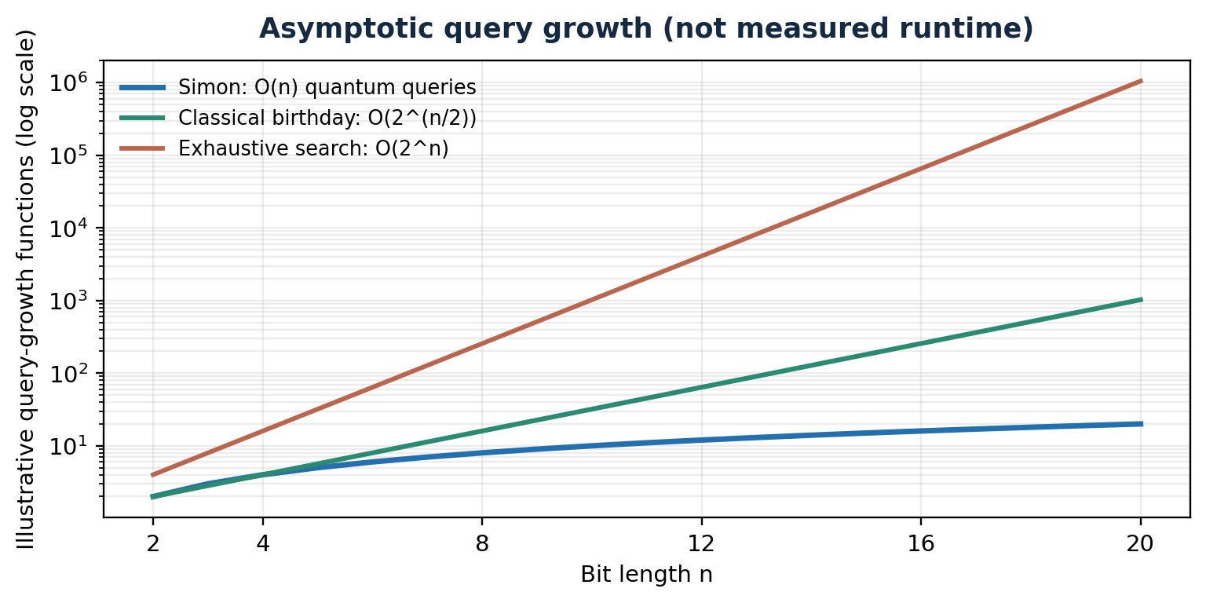
QUANTUM COMPUTING / EVEN–MANSOUR × SIMON
09
WHY THE SELECTED SOLUTION
Why Simon has the relevant quantum advantage
An asymptotic query advantage — not a measured laptop speedup.
SIMON: O(n)
One linear equation per quantum sample; solve over GF(2).
CLASSICAL: O(2ⁿᐟ²)
Birthday collision search in the same black-box model.
Important: the two-to-one promise and coherent oracle access are required.
IA III · QUANTUM COMPUTING · THEORY → SIMULATOR → KEY RECOVERY
09
Notes:
Use this plot only as illustrative asymptotic growth. Simon is asymptotically optimal in quantum query complexity for the exact Simon problem; this does not imply fastest wall-clock time or that arbitrary Even–Mansour permutations give a unique period. The circuit synthesis cost and hardware noise matter for practicality.

Slide 10
QUANTUM COMPUTING / EVEN–MANSOUR × SIMON
10
IMPLEMENTATION DESIGN
How we implemented and tested the algorithm
The experiment includes a genuine reversible quantum oracle.
01
DEFINE
3-bit P, simulated cipher keys
LIVE SIMULATION
Qiskit StatevectorSampler
6 qubits · 1,024 shots
Ideal noiseless simulator
02
BUILD
Reversible U_E and U_P gates
03
EXECUTE
H → U_E → U_P → H → measure
04
SOLVE
GF(2) equations; recover k₁ & k₂
VALIDATED BASELINE
Separate executed NumPy statevector experiment; measured counts used on next slide.
05
VALIDATE
Compare theory + all eight inputs
IA III · QUANTUM COMPUTING · THEORY → SIMULATOR → KEY RECOVERY
10
Notes:
Explain that the main Qiskit code constructs E and P as reversible bitwise-XOR lookup operations. We apply H to the three input qubits, oracle E then P to the six-qubit register, then H on the inputs, and measure. Independently, a custom NumPy statevector simulator was executed for the report; do not label those measurements as Qiskit measurements.

Slide 11
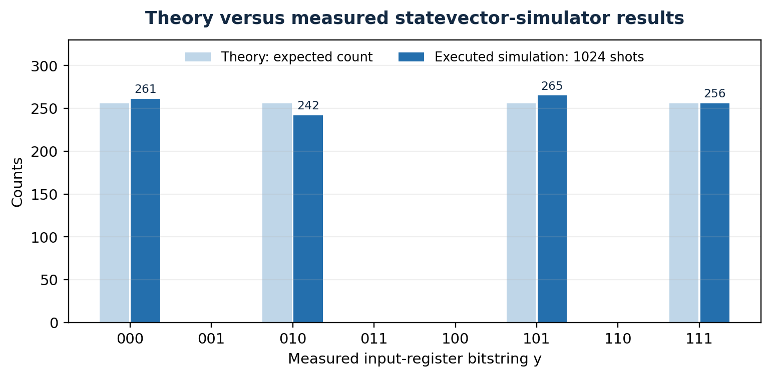
QUANTUM COMPUTING / EVEN–MANSOUR × SIMON
11
THEORY VS SIMULATION
Do the observed measurements match the math?
Executed NumPy statevector baseline: 1,024 shots.
OBSERVED
000 → 261
010 → 242
101 → 265
111 → 256
All other counts = 0
THEORY: four outcomes × 25% each | SIMULATION: matching support, keys 101 and 011.
IA III · QUANTUM COMPUTING · THEORY → SIMULATOR → KEY RECOVERY
11
Notes:
Be precise that the plotted measured baseline is from the NumPy statevector simulation we actually executed, not a Qiskit screenshot. Each valid outcome has theoretical expectation 256 of 1024; sampling fluctuation produces counts 261, 242, 265, 256. No invalid output was measured. The statevector process and key reconstruction matched theoretical predictions. During the live demo, Qiskit will generate a new histogram that is expected to have similar but not identical counts.

Slide 12
QUANTUM COMPUTING / EVEN–MANSOUR × SIMON
12
SCIENTIFIC INTERPRETATION
What these results prove — and what they do not
Strong mathematical demonstration, carefully limited claims.
WHAT WE VERIFIED
WHAT WE DID NOT CLAIM
The exact 3-bit oracle has the promised period; measurements give valid equations; both keys are recovered and checked.
A practical 3-bit runtime speedup, real hardware execution, or that every Even–Mansour permutation satisfies Simon’s exact promise.
TECHNICAL CONSTRAINTS
REAL-WORLD LESSON
Real devices have noise, limited connectivity, gate depth constraints, and costly coherent oracle construction.
Quantum cryptanalysis motivates stronger security assumptions and responsible adoption of quantum-resistant cryptography.
Educational result: exact simulated recovery, not a break of deployed cryptography.
IA III · QUANTUM COMPUTING · THEORY → SIMULATOR → KEY RECOVERY
12
Notes:
Explain that the 2-bit version is degenerate; for larger random permutations the f function has a guaranteed period but may have extra collisions. Simulators are ideal and hide hardware noise. This is not evidence of breaking a production cipher. Real quantum cryptanalytic threats depend on oracle access and coherent circuit resources.

Slide 13
QUANTUM COMPUTING / EVEN–MANSOUR × SIMON
15
CONCLUSION
We solved the question — and checked it experimentally
The result is a reproducible demonstration of quantum period finding.
PROOF
QUANTUM CIRCUIT
KEY RECOVERY
f(x ⊕ k₁) = f(x)
Six qubits; Simon’s measurements
k₁ = 101 and k₂ = 011
THEORY + SIMULATION + EXPLANATION
Core references: D. Simon, SIAM J. Comput. (1997) • IBM Quantum Learning, Simon’s Algorithm • Qiskit documentation
THANK YOU
IA III · QUANTUM COMPUTING · THEORY → SIMULATOR → KEY RECOVERY
15
Notes:
Recap exactly what we proved and measured. Prepare for questions: Why 3 bits? Because n=2 gives constant f. Why Simon? Because the function has an XOR period. How do you get k2? E(0) XOR P(k1). Is the 3-bit program faster? No meaningful wall-clock speedup is shown; advantage is asymptotic query complexity. Do real hardware results match perfectly? Noise and coherence constraints make that a separate experiment.

